Slide 1
Person’s Income
Submitted by: Rida Riaz

Slide 2
Introduction
I take a dataset of multiple people with different race, native country, marital status, gender etc and check whose income is greater than 50K.
I also use many visualizations graphs and plots to visualize the data.
Other than this I also use multiple algorithm like AdaBoost, decision tree, random forest, naïve bayes, and KNN etc. to check which algorithm gives the best accuracy.

Slide 3
Dataset Information
Dataset name: Census.cvs

Slide 4
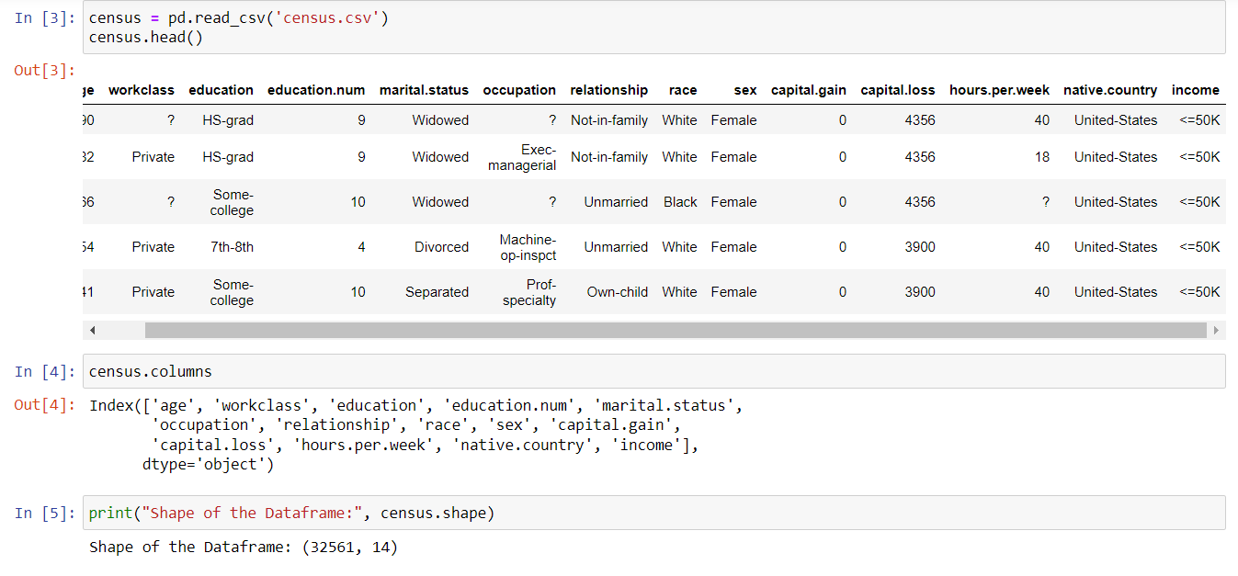
Data set Columns

Slide 5
Data Handling
Dataset name: Census.cvs

Slide 6
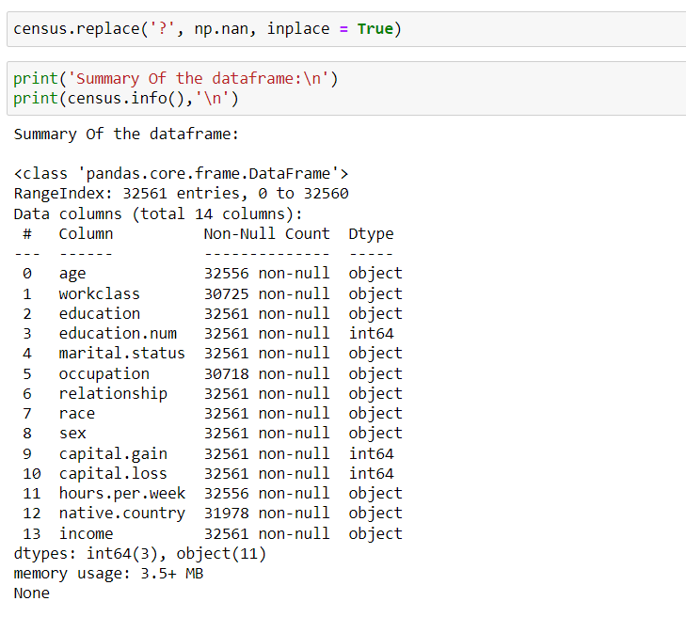
Converting ‘?’ with NaN

Slide 7
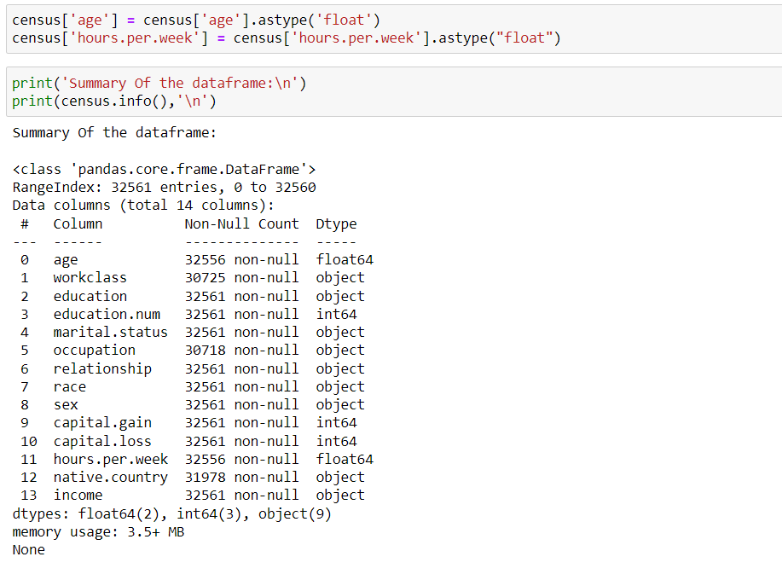
Coverting the datatype of "age", "hours.per.week"

Slide 8
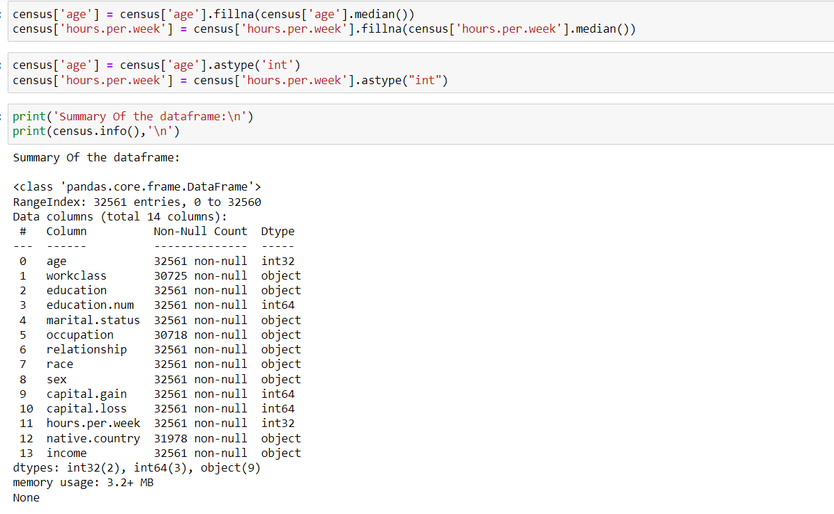
Replace missing numerical value with median and then change the datatype from float to int

Slide 9
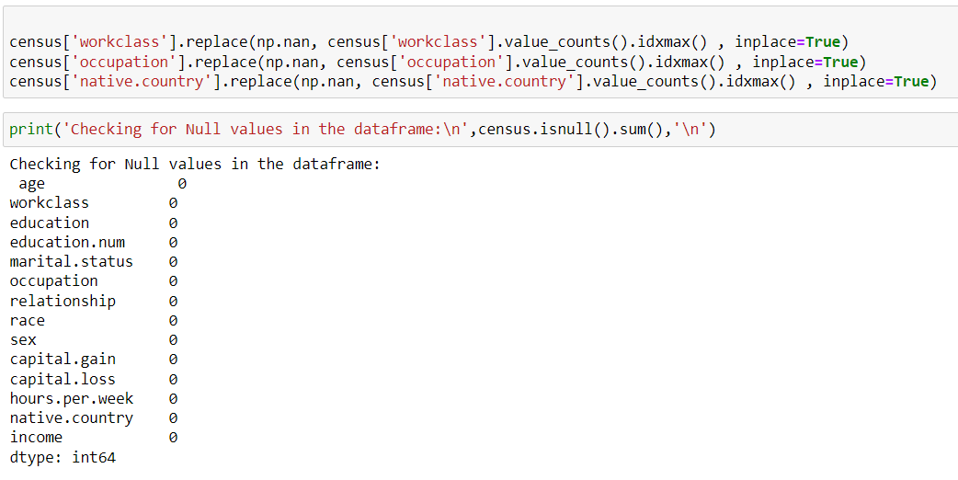
Filling all the missing categorical values with the values whose frequency is greater

Slide 10
Exploratory Data Analysis
Dataset name: Census.cvs

Slide 11
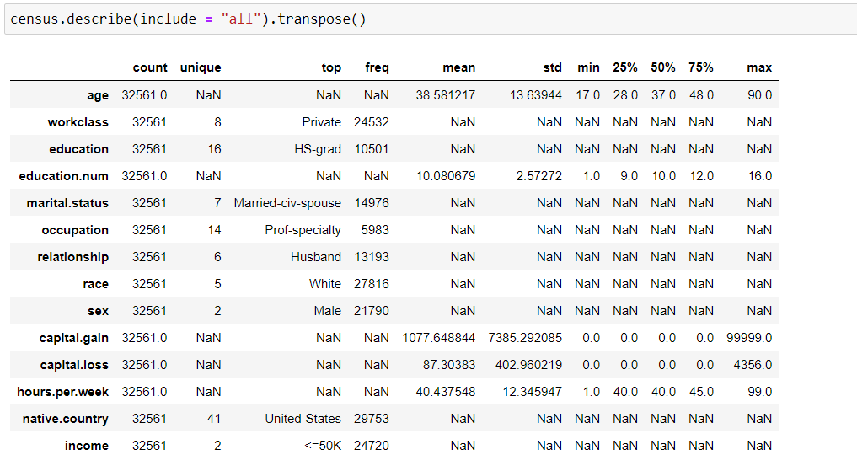
Data Description

Slide 12
Data Description
age: This represent age of the person. Minimum age of the person is 17 and maximum is 90. As mean > median, it's rightly skewed.
workclass: This column represent the sector in which a person work. It has 8 unique values. And mostly people worked in private sector (24532)
Education: This column represent the education of a person. It has 16 unique values. And mostly people are HS-grad (10501)
education.number: Level of education range from 1 - 16. As Mean slightly > Median, it's slightly rightly skewed.
marital.status: The column represent the marital status of a person. It has 7 unique values. And mostly people are Married-civ-spouse (14976)
occupation: The column represent the occupation of a person. It has 14 unique values. And mostly people are Prof-specialty (5983)
relationship: The column represent the relationship of a person in family. It has 6 unique values. And mostly people are Husband (13193)
race: The column represent the race of a person. It has 5 unique values. And mostly people are of White race(27816)
sex: The column represent the gender of a person. It has 2 unique values. And mostly people are Male (21790)
capital.gain: Capital gain by a person from 0 - 99999. As Mean highlty > Median, it's Highly rightly skewed.
capital.loss: Capital loss by a person from 0 - 4356. As Mean highlty > Median, it's Highly rightly skewed.
hours.per.week: This represent the working hours of the person in a week. Minimum working hours by the person is 1 and maximum is 99. As Mean slightly > Median, it's slightly rightly skewed.
native.country: The column represent the native country of a person. It has 41 unique values. And mostly people's native country is United-States(29753)
income: Our taget column value is income and we wanted to check whose person like which race, education,etc people have income greater than 50K

Slide 13
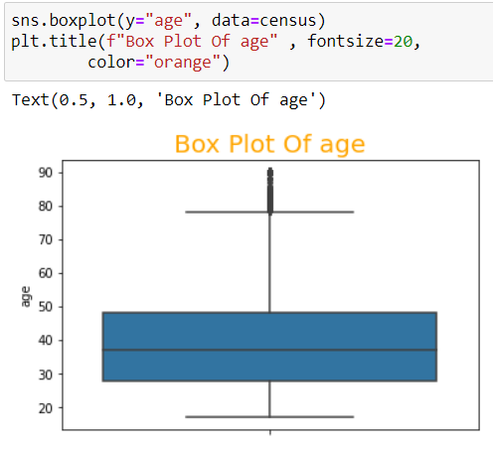
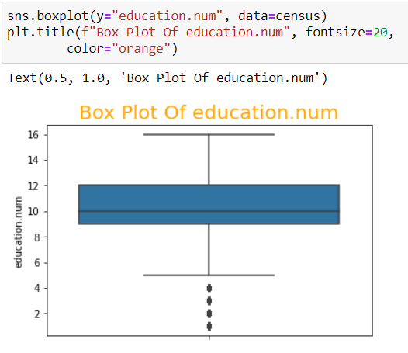
Univariate Analysis - by Boxplot

Slide 14
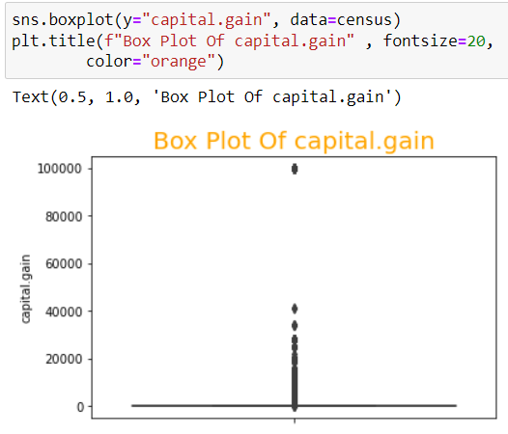
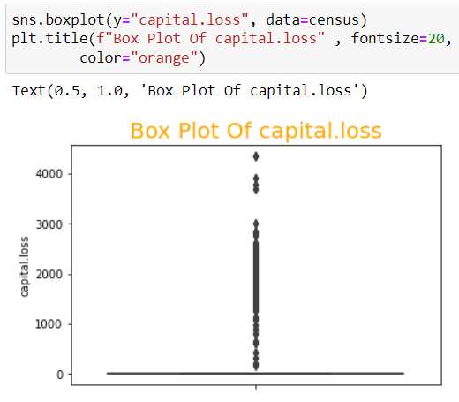
Univariate Analysis - by Boxplot

Slide 15
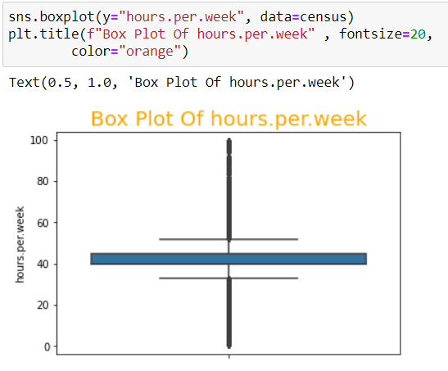
Univariate Analysis - by Boxplot

Slide 16
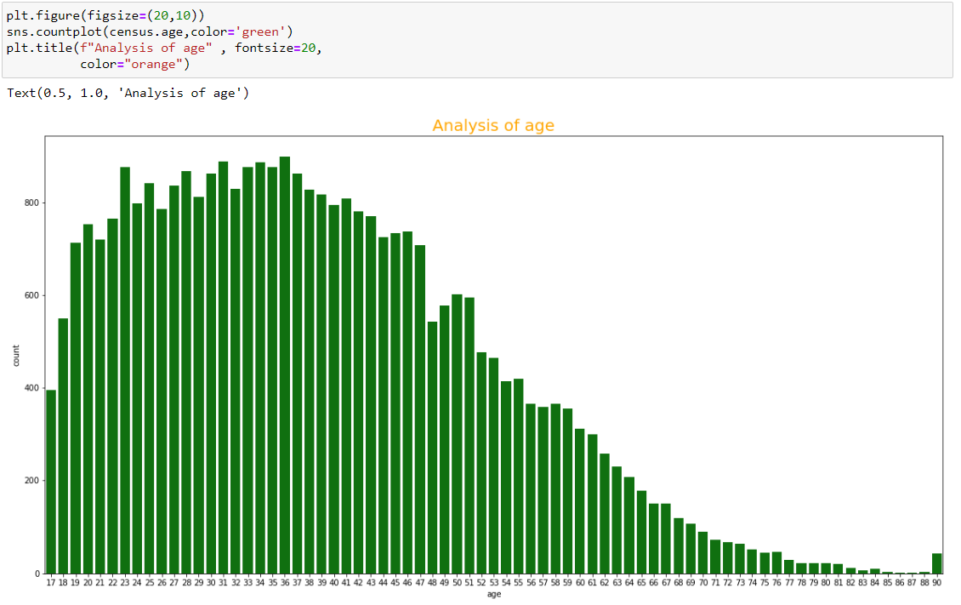
Univariate Analysis - by CountPlot
mostly people are of age 36

Slide 17
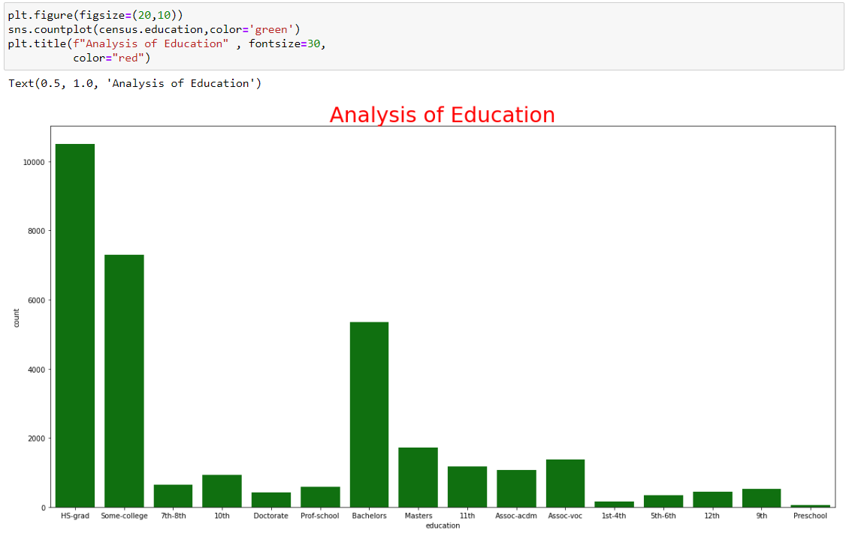
Univariate Analysis - by CountPlot
Mostly people are high school graduates

Slide 18
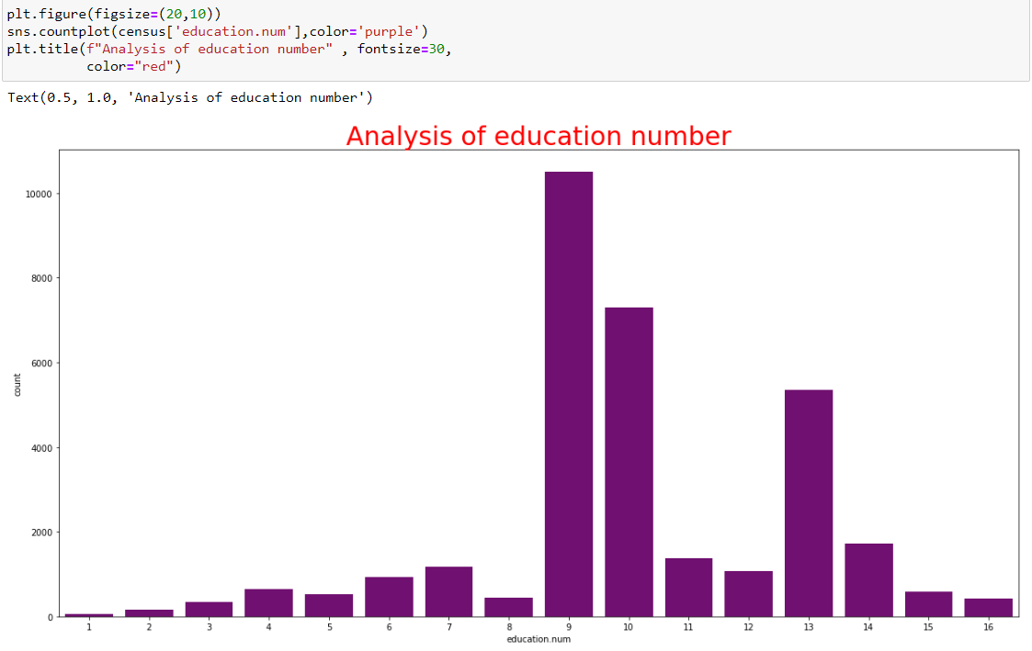
Univariate Analysis - by CountPlot
Mostly people education level is 9 which means mostly people are High-School graduates

Slide 19
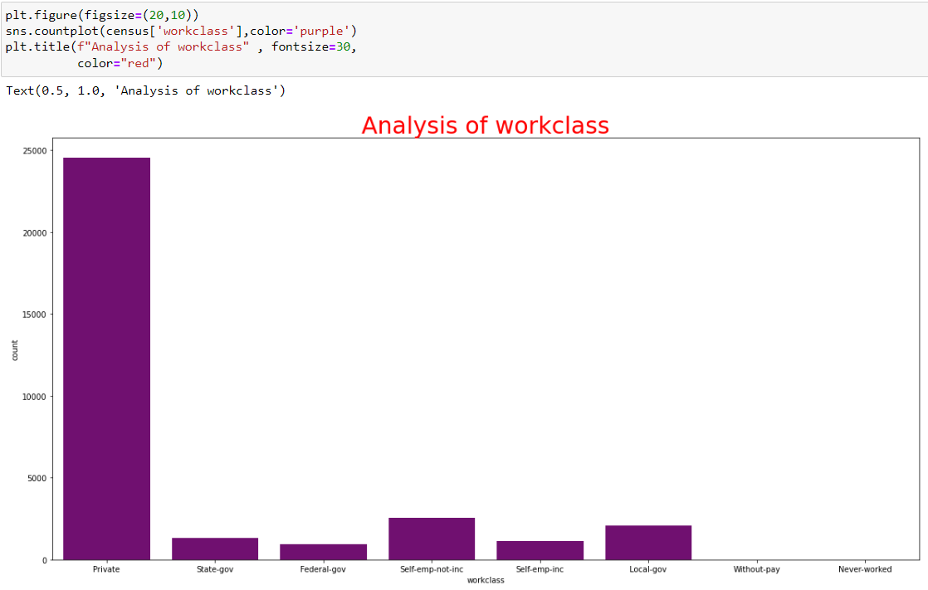
Univariate Analysis - by CountPlot
Mostly people doing jobs in private sectors

Slide 20
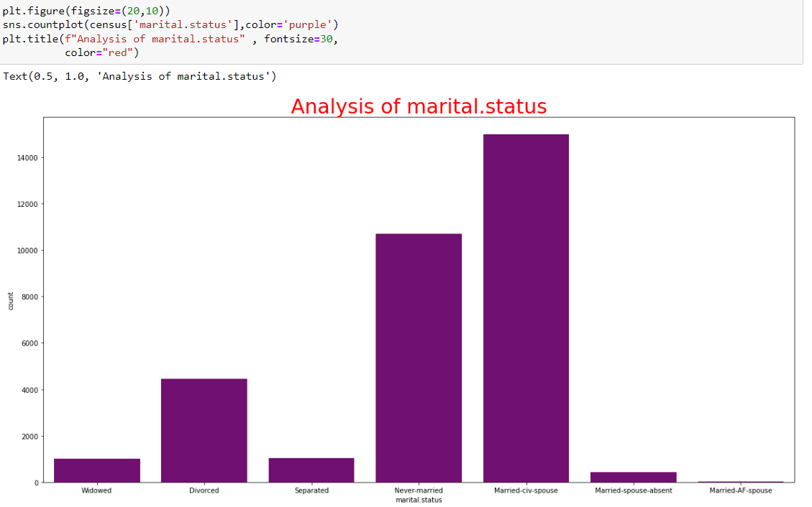
Univariate Analysis - by CountPlot
Mostly people are married-civ-spouse

Slide 21
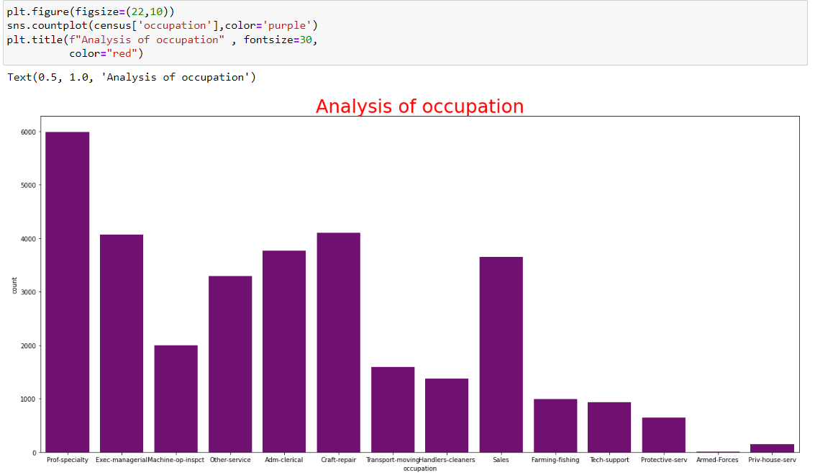
Univariate Analysis - by CountPlot
Mostly people occupation is prof-speciality

Slide 22
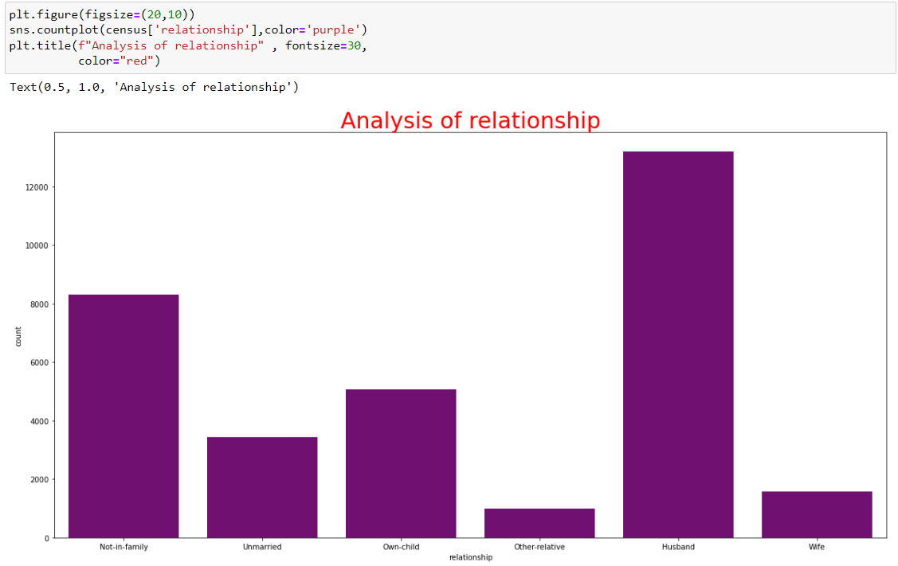
Univariate Analysis - by CountPlot
Moslty people are husbands

Slide 23
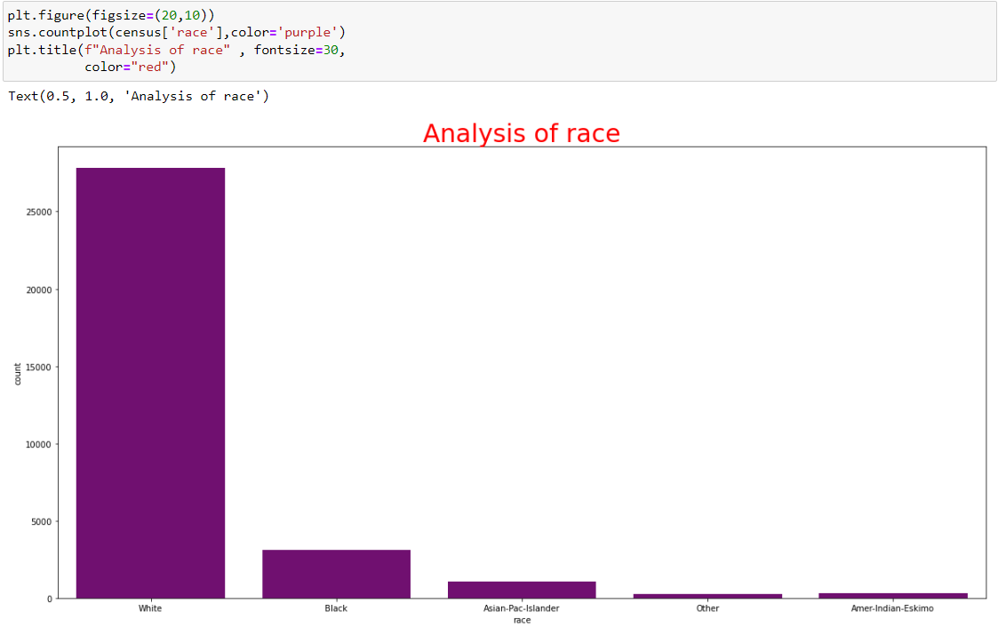
Univariate Analysis - by CountPlot
Mostly people are white

Slide 24
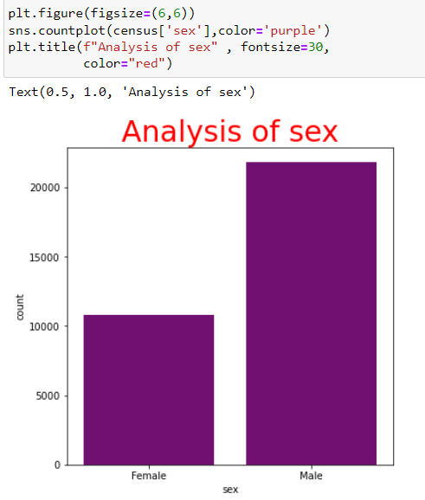
Univariate Analysis - by CountPlot
Mostly people are male

Slide 25
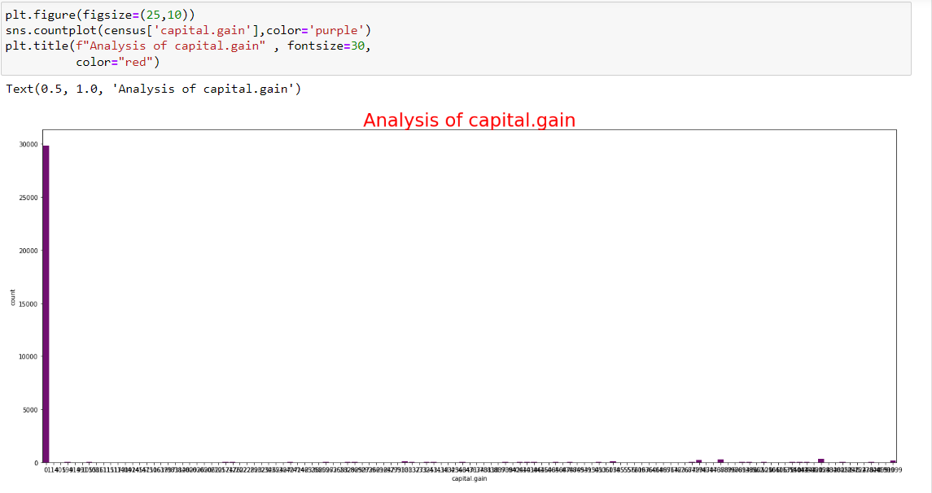
Univariate Analysis - by CountPlot
Mostly people capital gain is 0

Slide 26
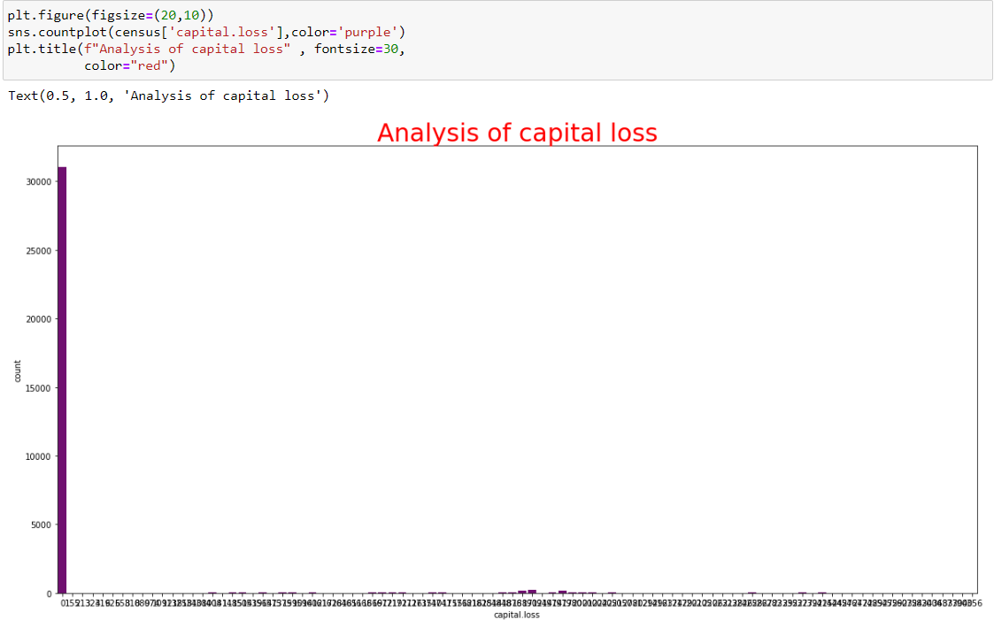
Univariate Analysis - by CountPlot
Mostly people capital loss is 0

Slide 27
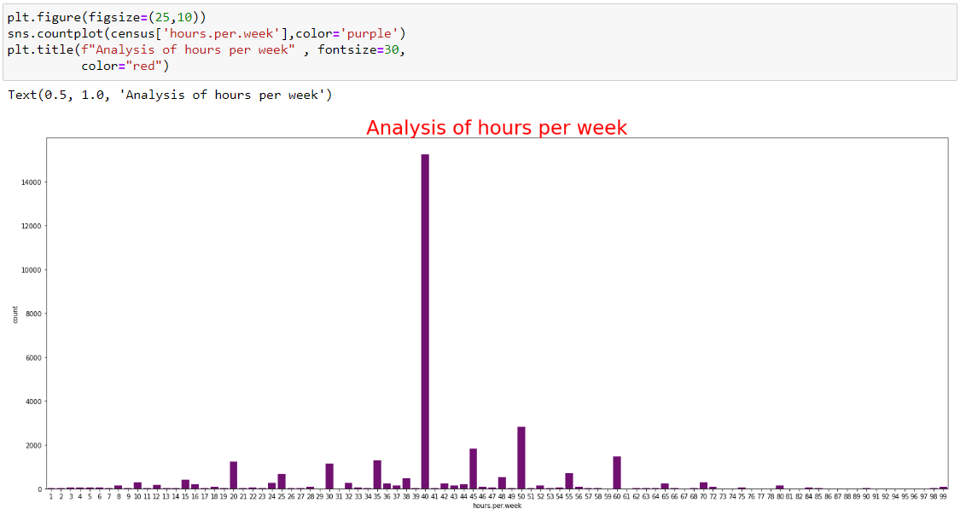
Univariate Analysis - by CountPlot
Mostly people work 40 hours per week

Slide 28
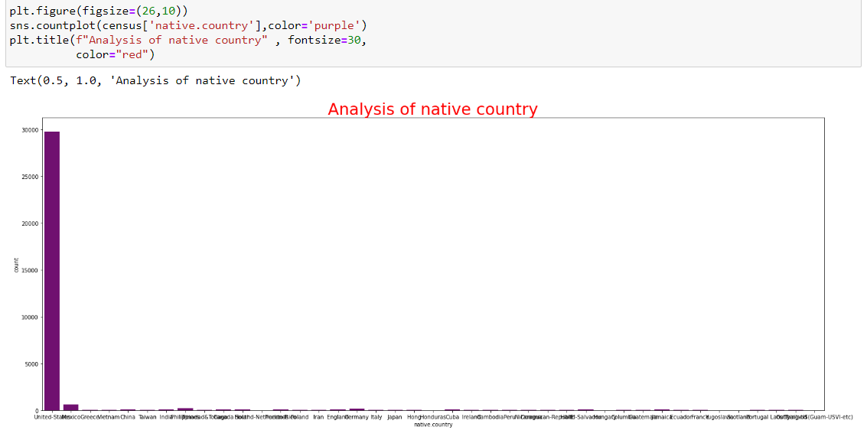
Univariate Analysis - by CountPlot
mostly people lived in United-states

Slide 29
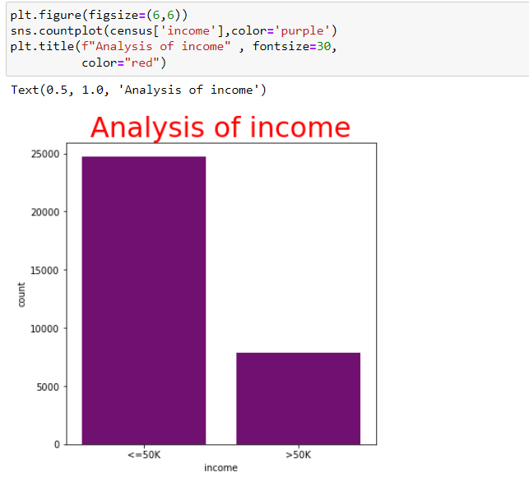
Univariate Analysis - by CountPlot
Mostly people income is <=50K

Slide 30
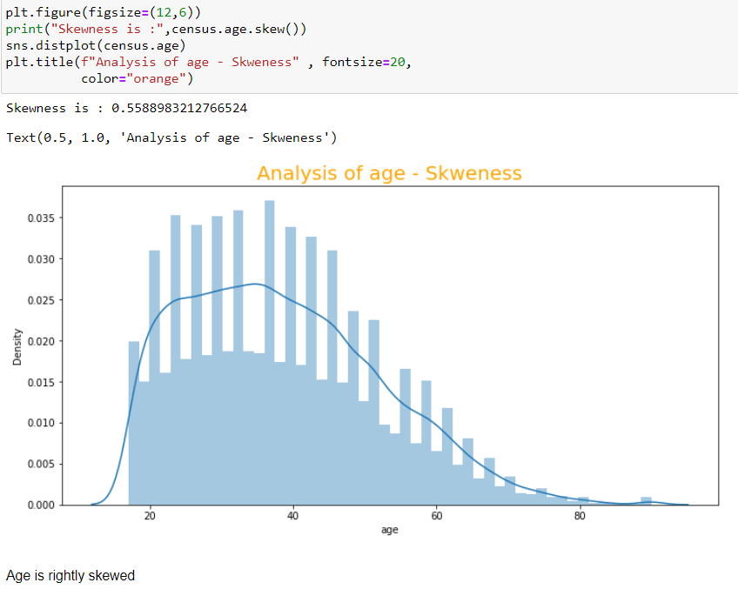
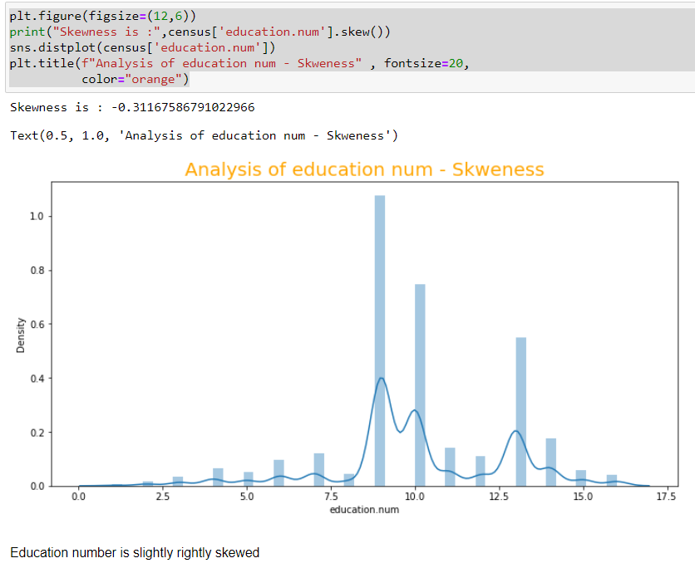
Univariate Analysis - by Distribution Plot

Slide 31
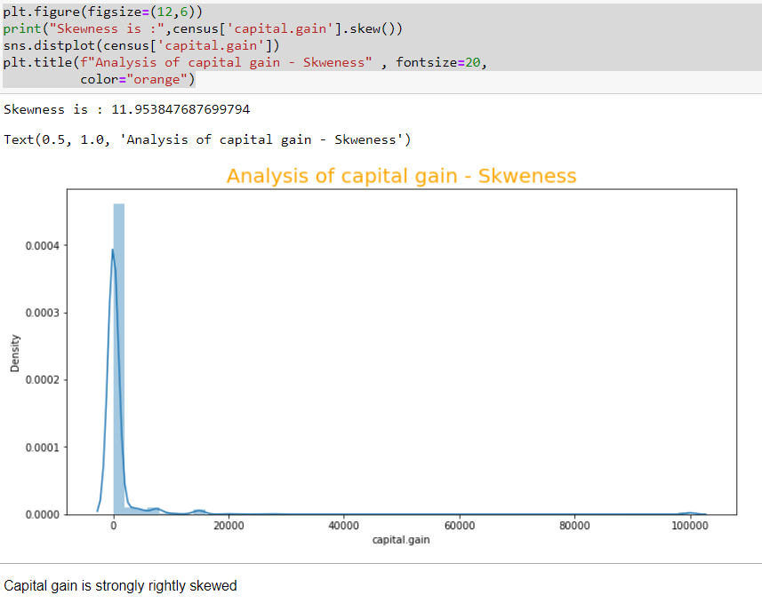
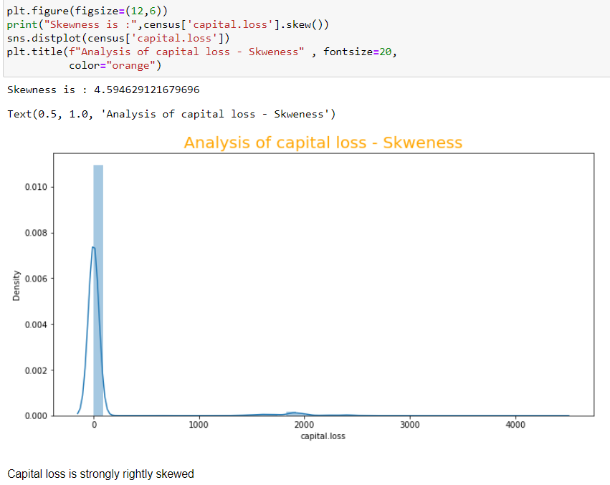
Univariate Analysis - by Distribution Plot

Slide 32
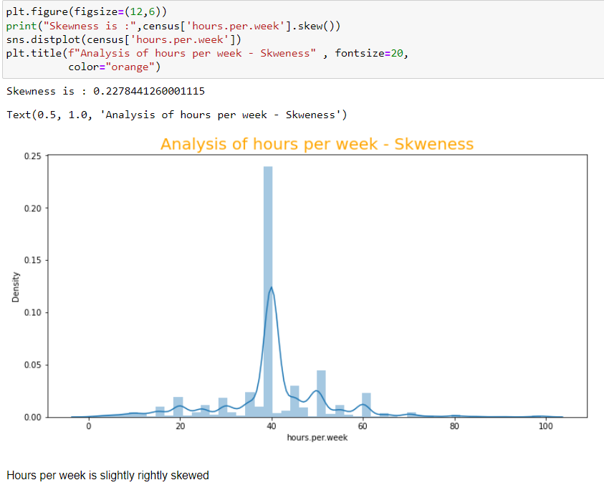
Univariate Analysis - by Distribution Plot

Slide 33
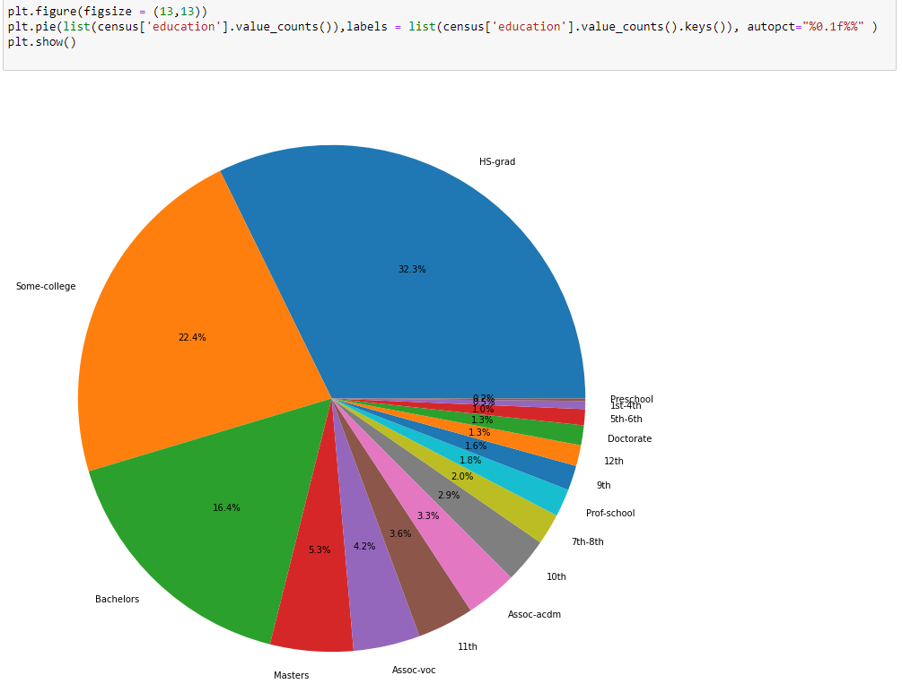
Univariate Analysis - by Pie Chart

Slide 34
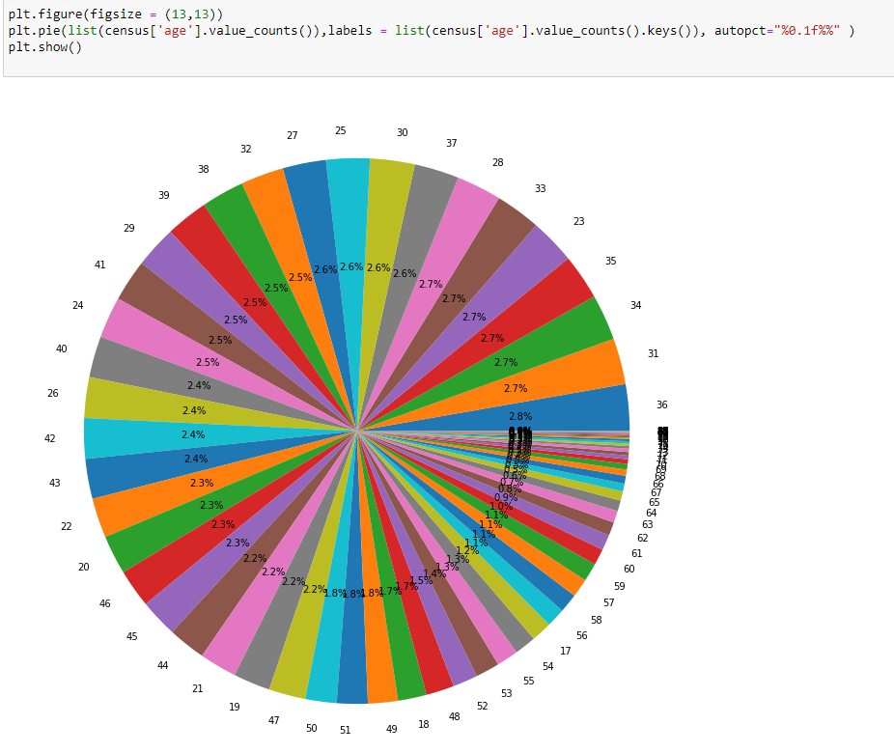
Univariate Analysis - by Pie Chart

Slide 35

Univariate Analysis - by Pie Chart

Slide 36
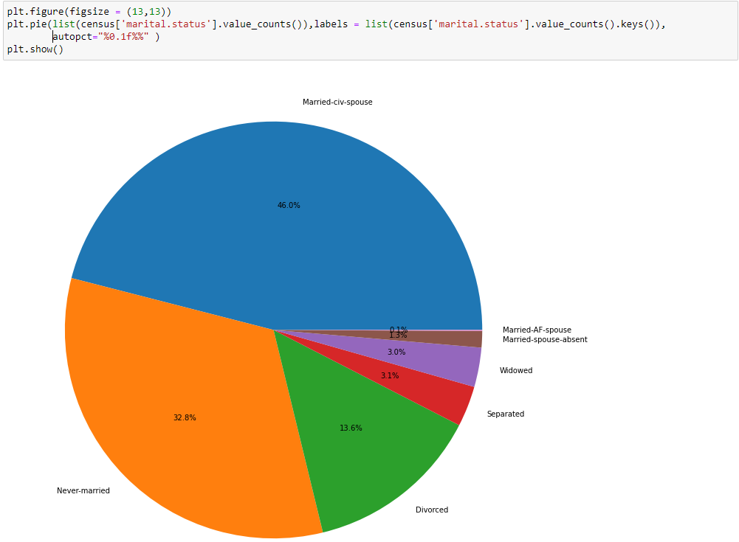
Univariate Analysis - by Pie Chart

Slide 37
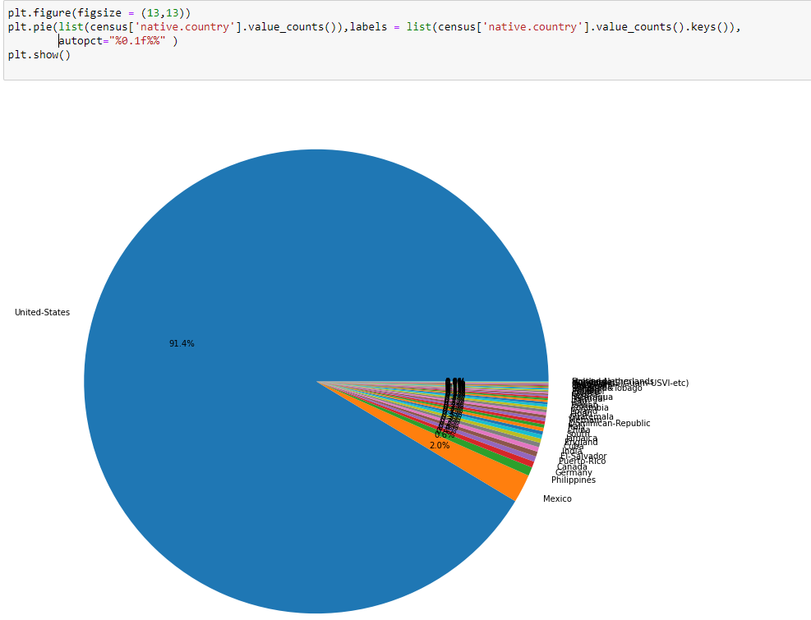
Univariate Analysis - by Pie Chart

Slide 38
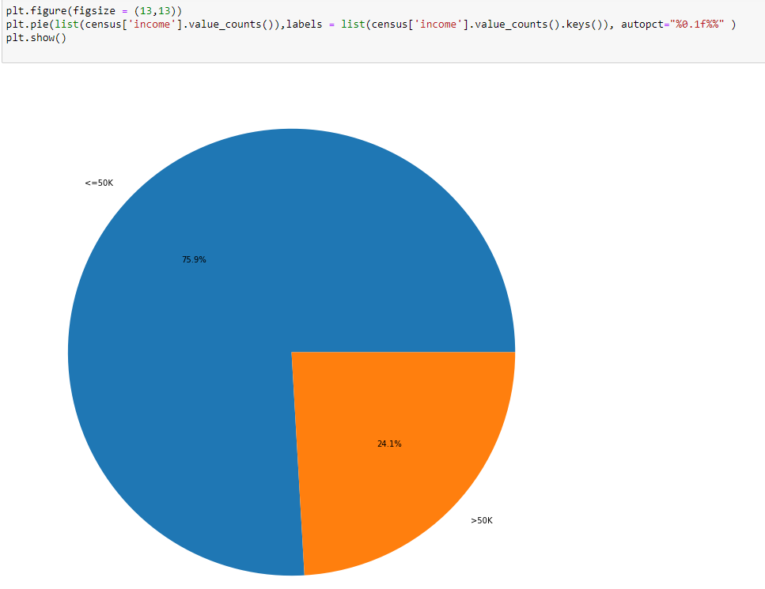
Univariate Analysis - by Pie Chart

Slide 39
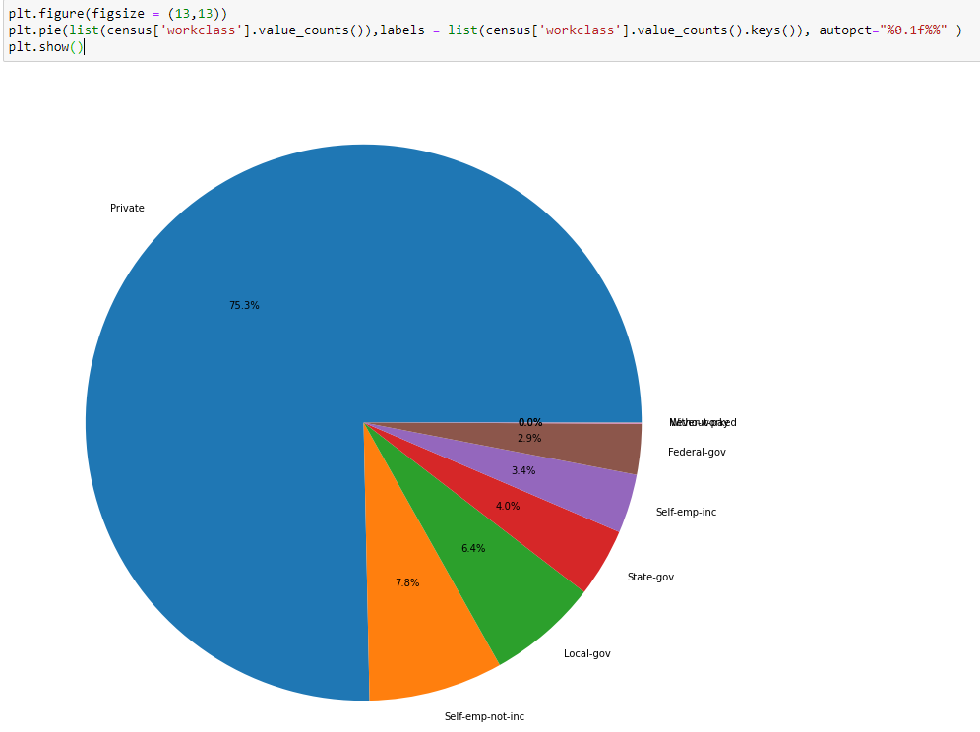
Univariate Analysis - by Pie Chart

Slide 40
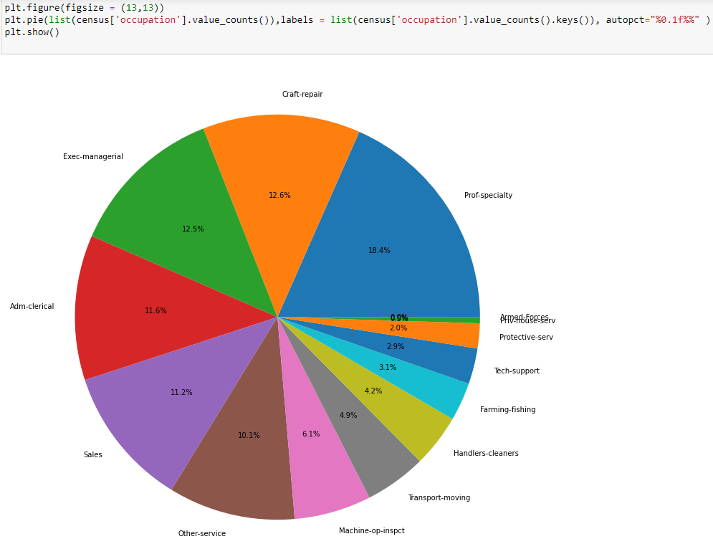
Univariate Analysis - by Pie Chart

Slide 41
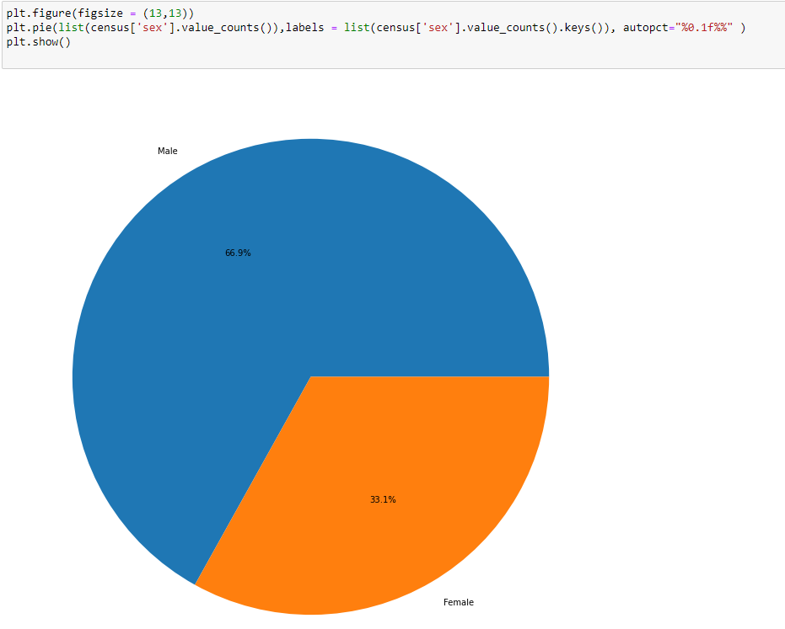
Univariate Analysis - by Pie Chart

Slide 42
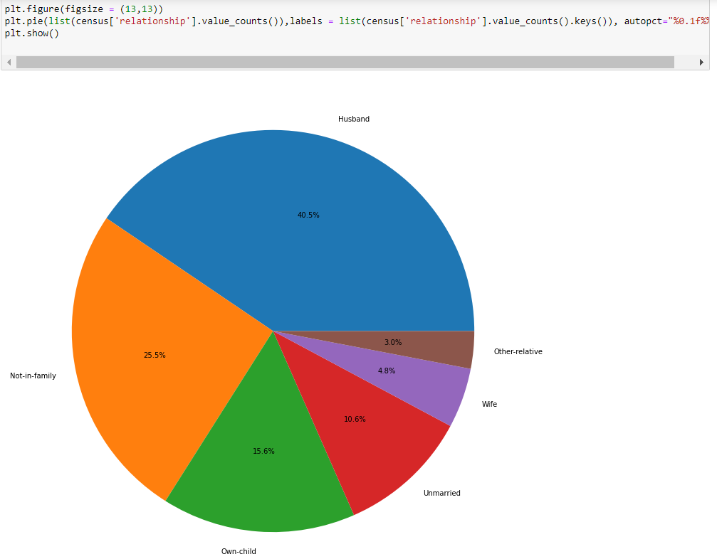
Univariate Analysis - by Pie Chart

Slide 43
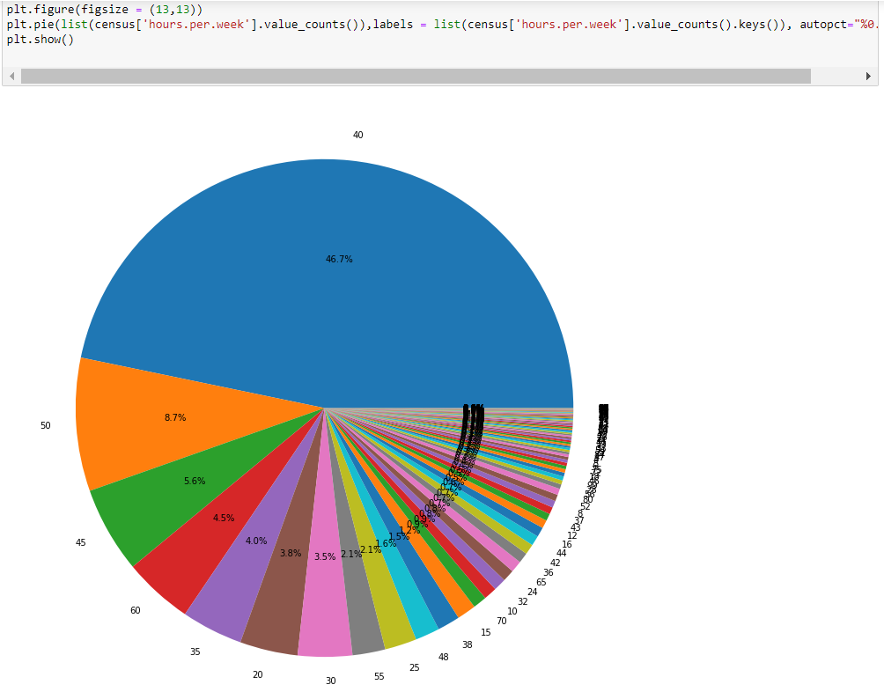
Univariate Analysis - by Pie Chart

Slide 44
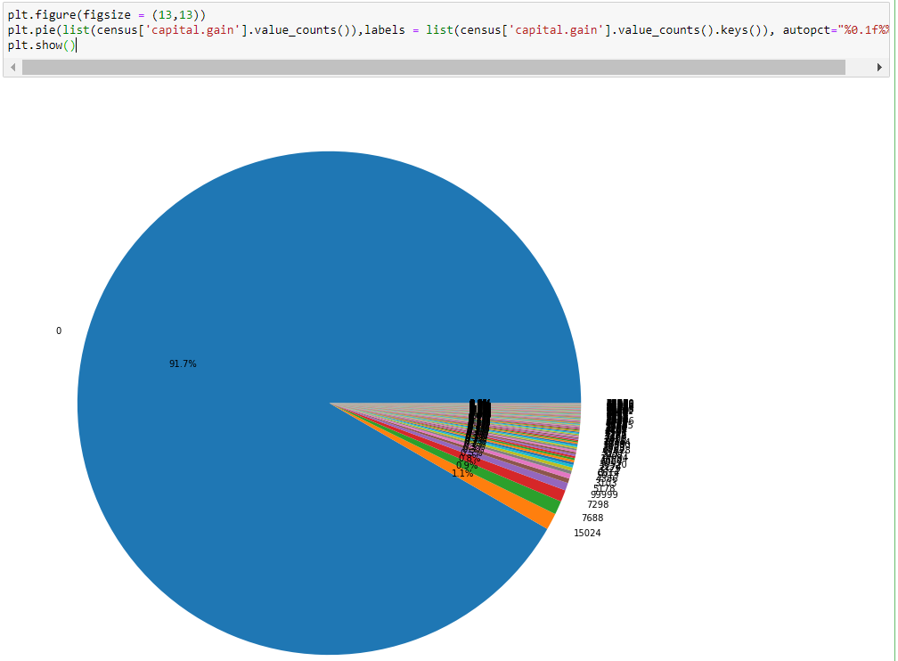
Univariate Analysis - by Pie Chart

Slide 45
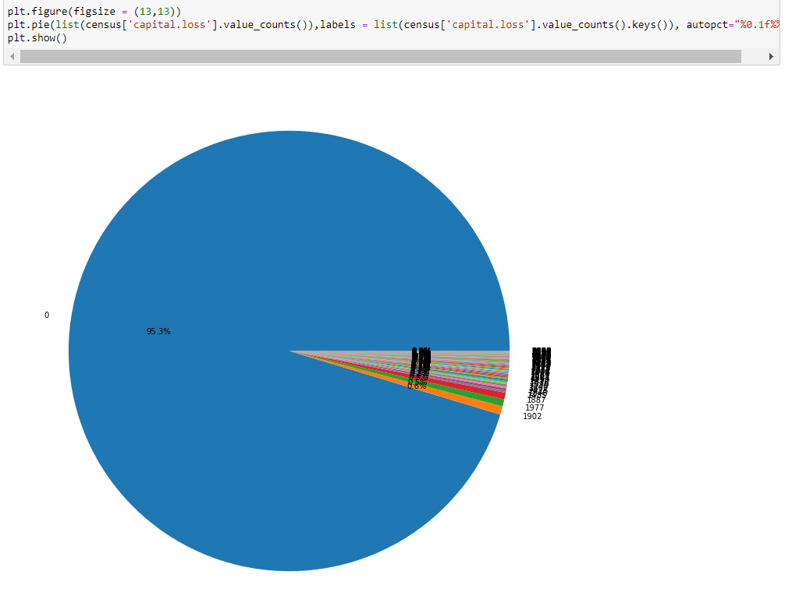
Univariate Analysis - by Pie Chart

Slide 46
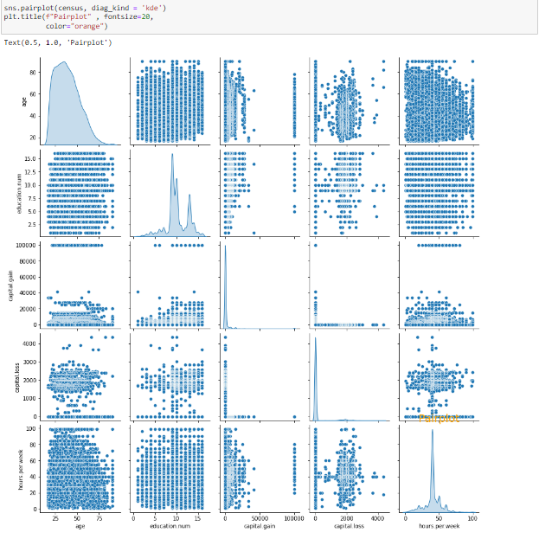
Pair Plot

Slide 47
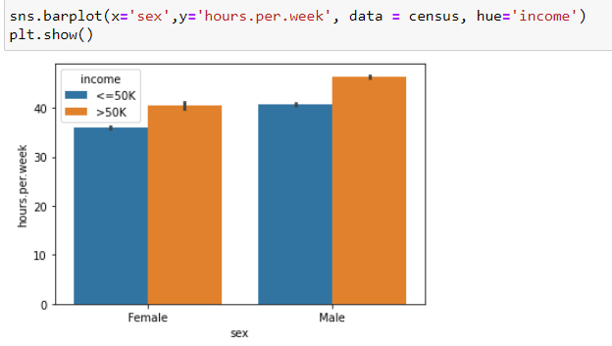
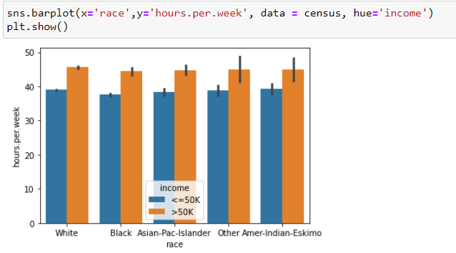
Bivariate Analysis - by Bar Plot

Slide 48
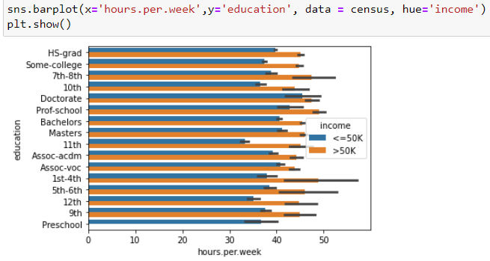
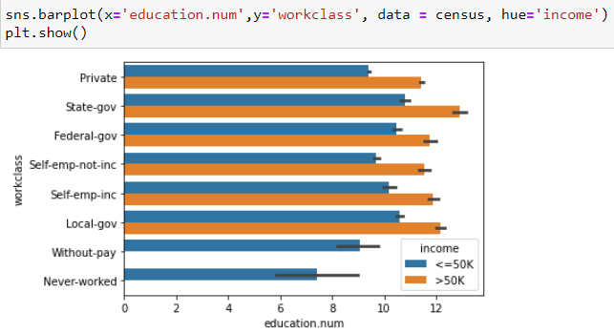
Bivariate Analysis - by Bar Plot

Slide 49
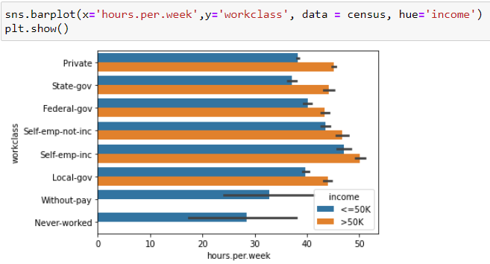
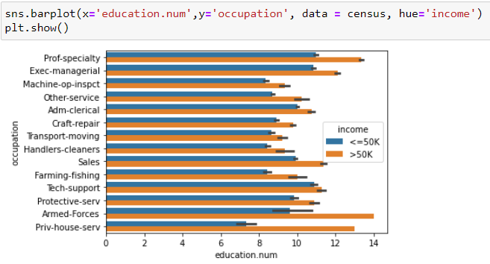
Bivariate Analysis - by Bar Plot

Slide 50
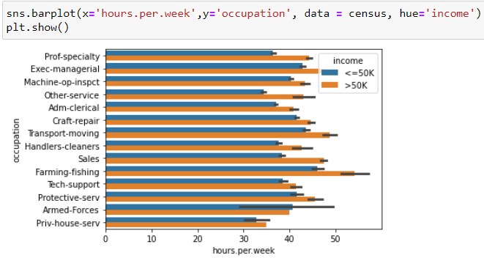

Bivariate Analysis - by Bar Plot

Slide 51


Bivariate Analysis - by Bar Plot

Slide 52

Bivariate Analysis - by Bar Plot

Slide 53

Bivariate Analysis - by Heat Map

Slide 54

Bivariate Analysis - by Correlation
AS we can see from the heat map and Correlation table the numerical columns are not really co-dependent

Slide 55
Modelling
Dataset name: Census.cvs

Slide 56

Decision Tree Classifier

Slide 57

Decision Tree Classifier

Slide 58

Random Forest Tree

Slide 59

Random Forest Tree (finding important features)

Slide 60

Random Forest Tree (finding important features)

Slide 61

KNN Classifier

Slide 62

Naïve Bayes Classifier

Slide 63

Ada Boost Classifier

Slide 64
Result
As we can see that Random forest Classifier gives the best accuracy.
All the column are not really co-dependent on each other

